Slide 1
LOAN MANAGEMENT SYSTEM
M.SAKTHI

Slide 2
MYSQL(Structured Query Language)
MySQL is an open-source relational database management system (RDBMS) that uses SQL (Structured Query Language) to store, manage, and retrieve data. It is widely used for web applications, enterprise software, and various data-driven applications.
Key Features of MySQL:
• Relational Database: Stores data in tables with rows and columns.
• SQL-Based: Uses structured query language (SQL) for querying and managing data.
• Open-Source: Free to use, with a paid enterprise edition available for advanced features.
• Scalability: Suitable for small applications as well as large-scale systems.
• High Performance: Optimized for speed and reliability.
• Security: Provides strong authentication, encryption, and access control mechanisms.
• Cross-Platform: Runs on Windows, Linux, macOS, and more.

Slide 3
SQL SERVERS
SQL servers are database management systems (DBMS) that use Structured Query Language (SQL) to store, retrieve, and manage data. They handle database operations for applications, websites, and enterprise systems.
Popular SQL Servers:
1.MySQL – Open-source, widely used in web applications
2.Microsoft SQL Server (MSSQL) – A commercial DBMS by Microsoft, commonly used in enterprise applications.
3. PostgreSQL – Advanced open-source RDBMS known for its extensibility and compliance with SQL standards.
4.Oracle Database – A powerful commercial RDBMS used in large-scale applications.
5.SQLite – A lightweight, embedded SQL database (no server required).
6.MariaDB – A MySQL fork, known for better performance and security features.

Slide 4
SQL DATABASE
DBMS
(Data base management system)
RDBMS
(Relational Data base management system)
A DBMS is software that manages and organizes data in a structured format. It allows users to store, retrieve, and manipulate data efficiently.
Key Features of DBMS:
•Data Management: Provides a way to store and retrieve data.
•No Relationships: Data can be stored without defining relationships.
•Less Complexity: Suitable for small-scale applications.
•No ACID Compliance: May not ensure data integrity in transactions.
An RDBMS is a type of DBMS that follows relational model, meaning data is stored in tables (rows and columns) and linked using relationships
Key Features of RDBMS :
•Structured Data Storage: Stores data in tables (rows & columns).
•Relationships Between Tables: Uses Primary Key and Foreign Key constraints.
•ACID Compliance: Ensures Atomicity, Consistency, Isolation, and Durability for data integrity.
•Normalization: Reduces data redundancy and improves efficiency

Slide 5
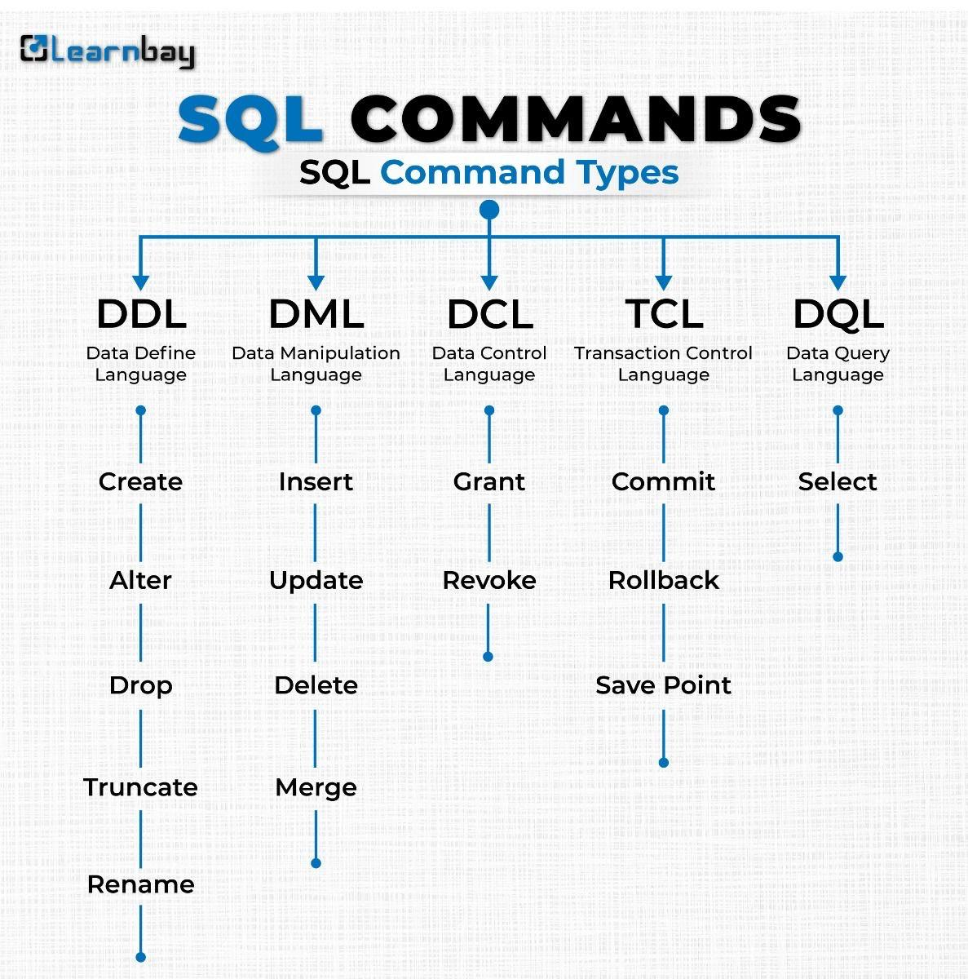
SQL COMMANDS

Slide 6
SQL COMMANDS
1. DDL (Data Definition Language) – Defines the Database StructureDDL statements are used to create, modify, or delete database objects like tables, indexes, and schemas.
2. DML (Data Manipulation Language) – Handles Data ManipulationDML statements are used to insert, update, delete, and manipulate data in tables.
3. DQL (Data Query Language) – Retrieves DataDQL consists of the SELECT statement, used to retrieve records from a table.
4. DCL (Data Control Language) – Manages User PermissionsDCL statements control user access and security in the database.
5. TCL (Transaction Control Language) – Manages TransactionsTCL statements ensure that transactions are executed correctly to maintain data integrity.

Slide 7
SQL QUERIES
1. SELECT: Retrieve data from a table.
2. WHERE: Filter rows based on conditions.
3. ORDER BY: Sort results in ascending or descending order.
4. GROUP BY: Group rows with similar values.
5. HAVING: Filter groups created by GROUP BY.
6. JOIN: Combine rows from two or more tables.
7. UNION: Combine results of multiple SELECT statements.
8. LIMIT: Restrict the number of rows returned.
9. INSERT INTO: Add new records to a table.
10. UPDATE: Modify existing records in a table.

Slide 8
S
10. UPDATE: Modify existing records in a table.
11. DELETE: Remove records from a table.
12. CREATE TABLE: Define a new table structure.
13. ALTER TABLE: Modify an existing table structure.
14. DROP TABLE: Delete a table and its data.
15. DISTINCT: Retrieve unique values from a column.
16. COUNT(): Count the number of rows.
17. SUM(): Calculate the total of a numeric column.
18. AVG(): Calculate the average value of a column.
19. ΜΙΝ() & ΜAX(): Retrieve the smallest and largest values in a column.
20.SUBQUERY: Nest a query inside another query to refine results.

Slide 9

PROJECT-LOAN MANAGEMENT SYSTEM

Slide 10
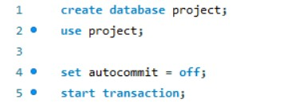
CREATING DATABASE:
DESCRIPSTION;
Creating database as“project” to use the database and after set the auto cmmit to “off” the perform the rollback and then start and execute transaction

Slide 11
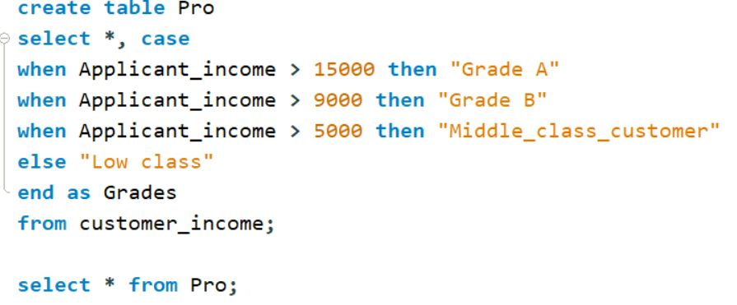
Code to set criteria:

Slide 12
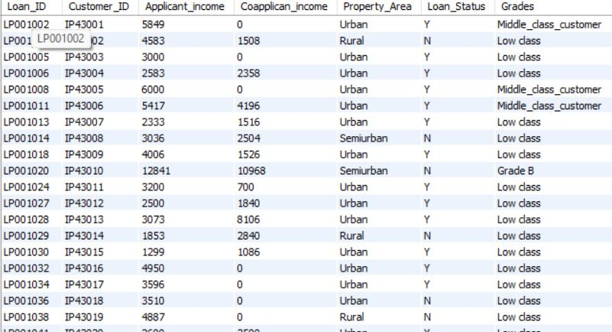
Table-1 “pro”

Slide 13
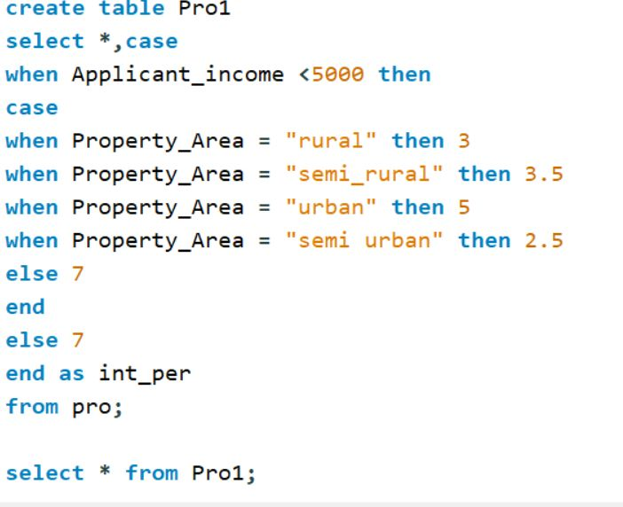
Code to Set Criteria

Slide 14
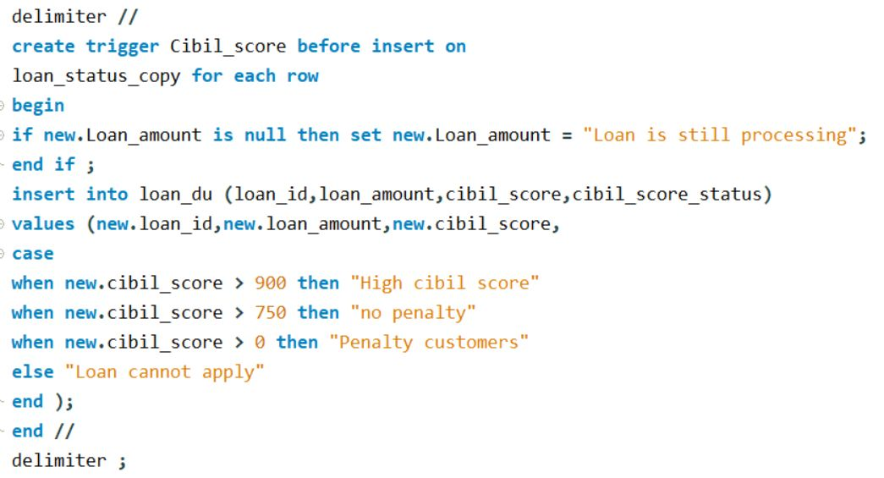
Creating Row Level Trigger and Statement level Trigger

Slide 15
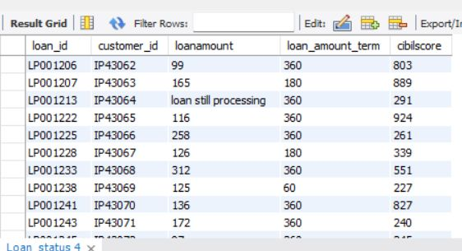
Loan still Processing Customers

Slide 16
Deleting the customers who’s application and loan amount are not processed

Slide 17
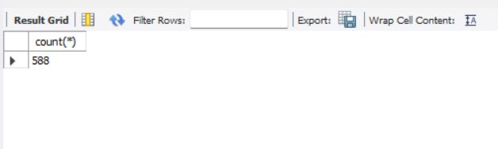
After Deleting the Customers the total Number of Customers are:

Slide 18
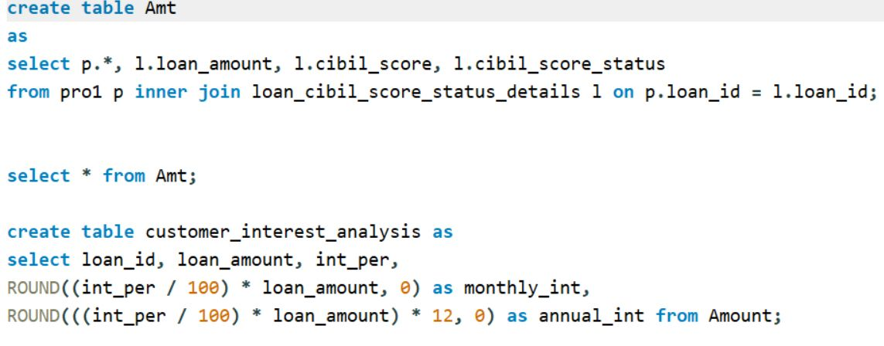
Annual and Monthly Interest Calculation

Slide 19
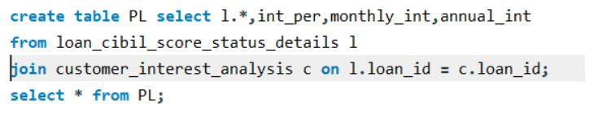
Join Tables

Slide 20
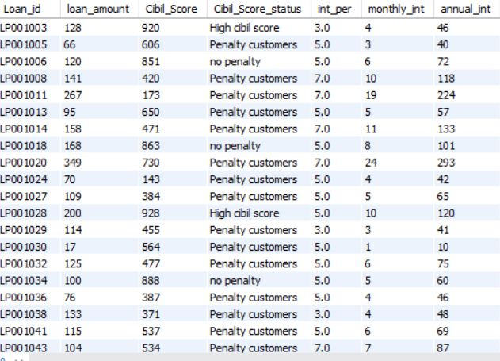
Out put for Join Tables

Slide 21
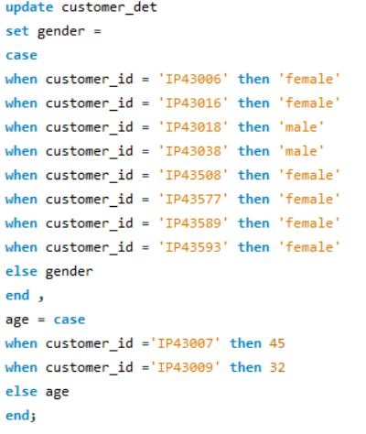
Updating the Gender and age of Customers

Slide 22
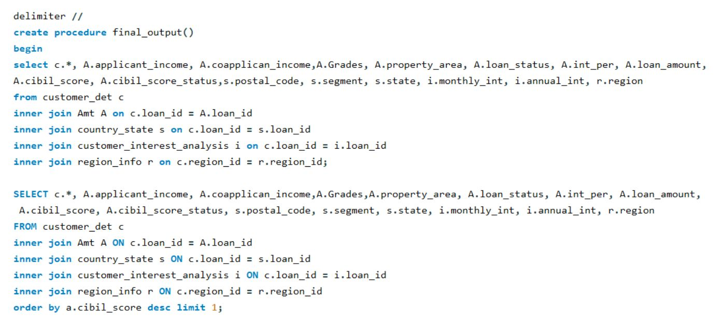
Create a Procedure called Final output and Include all Join Queries Together

Slide 23
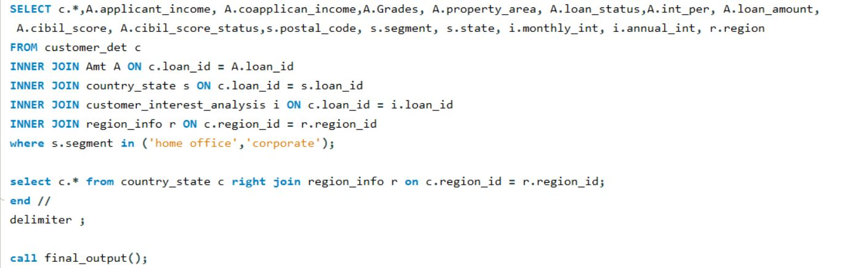
Ending the procedure using delimiter

Slide 24
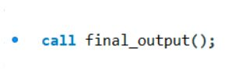
Calling procedure for all output

Slide 25
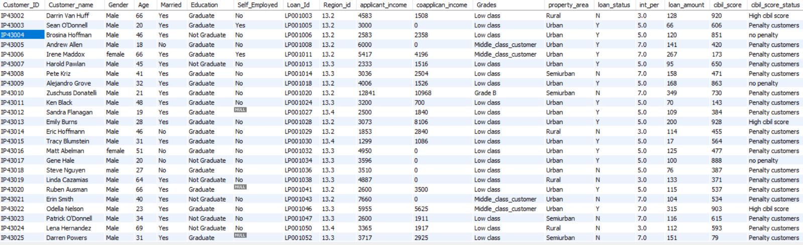
Output-1

Slide 26
Output-2

Slide 27
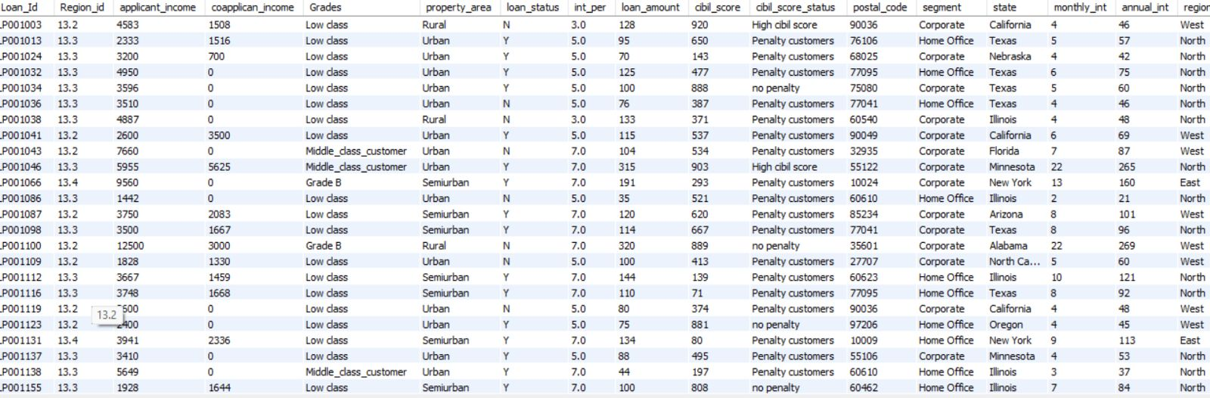
Output-3

Slide 28
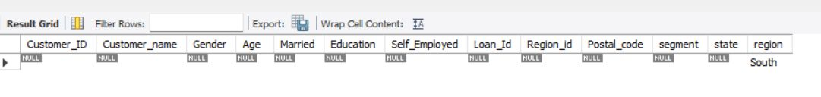
Output-4

Slide 29
I
THANK YOU

